Slide 1
DS6371 For Live Session Unit 2

Slide 2
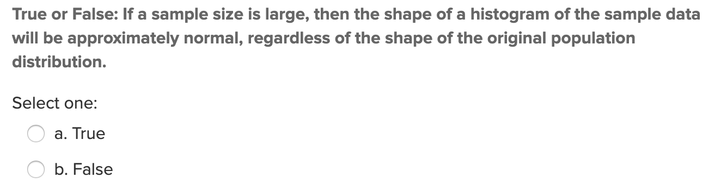
Quick quiz Question 1
Central limit theorem tells us that with sufficiently large sample sizes, the sampling distribution for the sample mean will be normally distributed, regardless of the shape of the underlying distribution we are sampling from.
However this does not mean the samples themselves will be normally distributed.

Slide 3
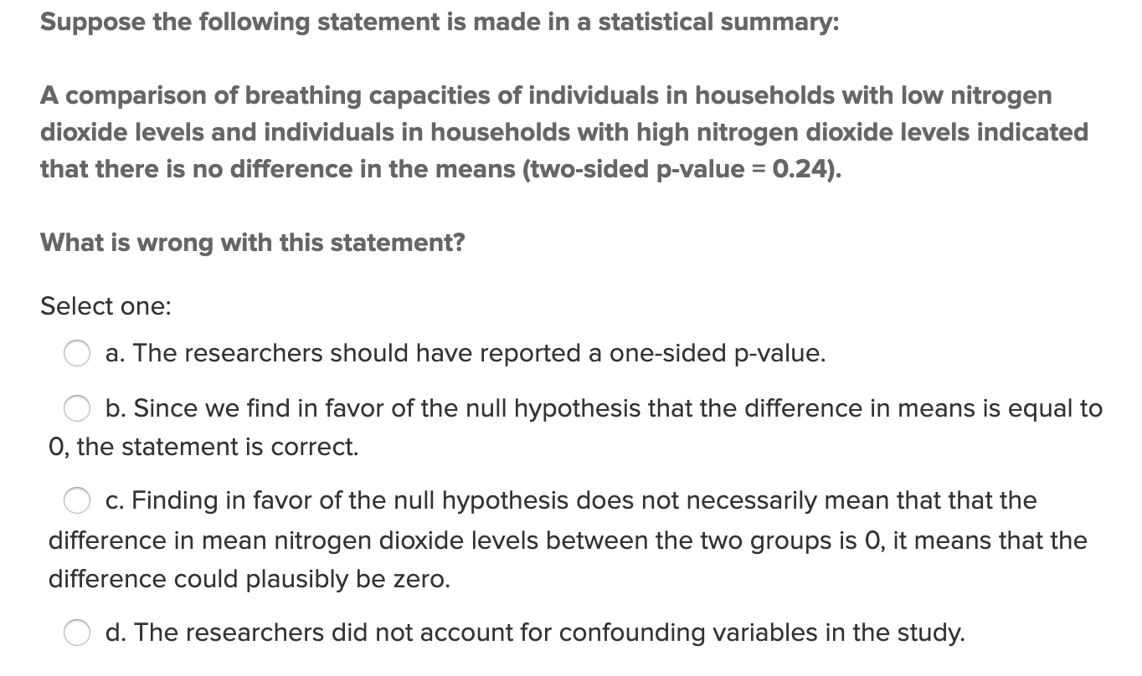
Quick quiz Question 2

Slide 4
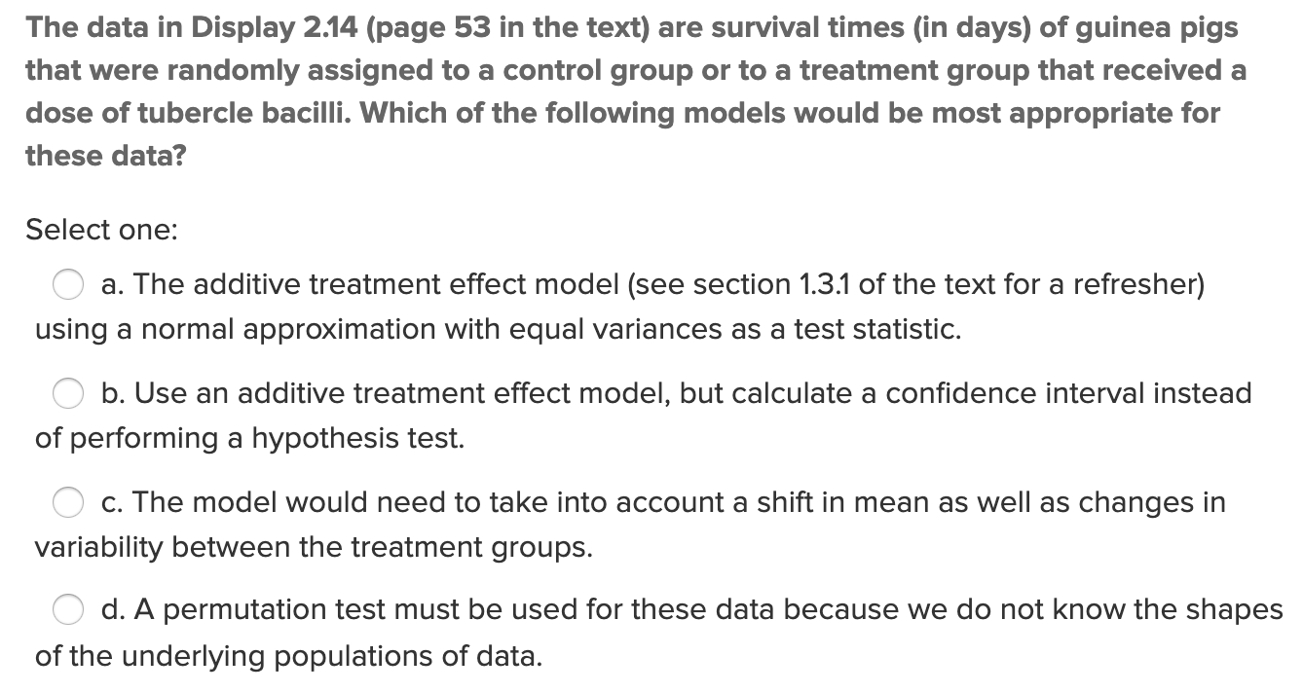
Quick quiz Question 3

Slide 5
Quick quiz Question 4
What is the formal definition of the p-value?
The p-value is the probability (i.e. percent chance) of observing a test statistic at least as extreme as the one we observed when we actually took a sample, due to random variation in the sampling process alone, if the value of the population parameter specified in the null hypothesis is correct (i.e. if the null hypothesis is correct). (Adapted from async video 2.7).

Slide 6
Quick quiz Question 4
What is the formal definition of the p-value?
In a randomized experiment the p-value is the probability that randomization alone leads to a test statistic as extreme as or more extreme than the one observed. (Statistical Sleuth page 13).
The p-value for a t-test is the probability of obtaining a t-ratio as extreme or more extreme than the test statistic in its evidence against the null hypothesis, if the null hypothesis is correct. (Statistical Sleuth page 44).
P-values indicate statistical significance, the extent to which a null hypothesis is contradicted by the data. This must be distinguished from practical significance, which describes the practical importance of the effect in question. (Statistical Sleuth page 102).
P-values indicate the strength of evidence from data in support of an alternative to a null hypothesis. (Statistical Sleuth page 165).
The p-value is the probability (i.e. percent chance) of observing a test statistic at least as extreme as the one we observed when we actually took a sample, due to random variation in the sampling process alone, if the value of the population parameter specified in the null hypothesis is correct (i.e. if the null hypothesis is correct). (Adapted from async video 2.7).

Slide 7

Question 2
Assume you wanted to test whether a new marketing strategy is increasing the mean total sales per day. You sample days at random under the old marketing system and 10 days at random under the new marketing system and record the mean sales for each group. You find that the 95 percent confidence interval for the difference of mean sales per day (μ_new-μ_old) is ($1.23, $1.60). You note that the new marketing strategy would cost $5.00 per day to implement. Is this result statistically significant? Why? Is this study practically significant? Why?
Statistical Significance
$$µ_{ new}−µ_{ old}$$
Now, we have a 95% confidence interval that does not contain zero. Is it possible that there actually is no difference in the true mean sales between the methods? Sure it is possible, but this interval tells us that if that is the case, then random chance gave us a very very nonrepresentative sample, because we know 95% of intervals created with this method will contain the true difference in means, and this interval is pretty far from zero. In other words, yes this result is statistically significant evidence of a difference between the two strategies.
Practical Significance
By the same logic as above, these results are likely not practically significant. In order to make a practical difference, we need the new strategy to make us money for it to be worth implementing. Since the strategy costs us $5 per day and our best-case plausible estimate of the increase in sales due to the strategy is $1.60, we would not implement this strategy since we would likely be losing money if we did so.

Slide 8
Question 3 – clt activity from section 2.2 of asynch
Consider again the Sleep 1 data from the asynch material. Using the same app:
https://www.rossmanchance.com/applets/2021/sampling/OneSample.html?population=sleep1
Now, take 500 random samples, each of size 5. What is the mean of the 500 means?
What is the range of the 500 sample means(smallest value and largest value)?
What is the standard deviation of the 500 sample means? You can find this value in the upper right corner of the graph on the lower right.
Describe the distribution of 500 sample means from samples of size 5 (think shape, center, and spread).
Run the following simulations using the applet. Click “reset” before each simulation!! For each simulation, obtain the mean and standard deviation of the 500 sample means.
a. Number of samples = 500, sample size = 10
b. Number of samples = 500, sample size = 20
c. Number of samples = 500, samples size = 50
For each of a, b, and c, above, describe the shape of the distribution of the 500 sample means relative to the original population distribution.
For each of a, b, and c, calculate sigma divided by the square root of n and compare this to the standard deviation of the distribution of the sample means from your simulation.

Slide 9
Clt activity
How do the distributions of simulated samples of the same sample size compare to one another (think center, shape, and spread). These are the samples that you see in the middle histogram.
Describe the distributions of the sample means for samples of size 5, 10, 20, and 50. How do these distributions compare to one another, and to the population distribution?
What would you expect to happen to the distribution of the sample means if we changed the sample size again, to a larger number?
What is the pattern that you see?
Fore Shadowing for the next section: Do you think the same pattern would result if we took samples and made distributions of sampling statistics for other types of populations (not sleep times)? Try it with “Pennies” and “Change”. (Note, the "Variable" needs to be set in the "Show Sampling Options" section.) What do you see?
Do you think the same pattern would result if we took samples and made distributions of other sampling statistics (not the mean)? Try it by punching the radio buttons for the median and standard deviation over the plot at the bottom right.

Slide 10
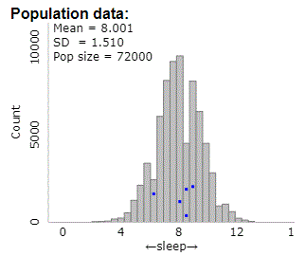
Question 3 – clt activity from section 2.2 of asynch
Consider again the Sleep 1 data from the asynch material. Using the same app:
http://www.rossmanchance.com/applets/OneSample.html?population=gettysburg
The population has an approximate normal distribution with mean approximately 8 and standard deviation 1.510.

Slide 11
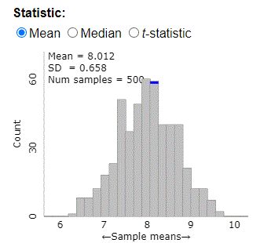
Question 3 – clt activity from section 2.2 of asynch
Consider again the Sleep 1 data from the asynch material. Using the same app:
http://www.rossmanchance.com/applets/OneSample.html?population=gettysburg
Now, take 500 random samples, each of size 5. What is the mean of the 500 means?
The mean of the 500 sample means is 8.012, which is very close to the mean of the population (8.001).

Slide 12
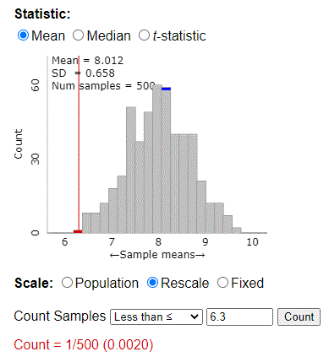
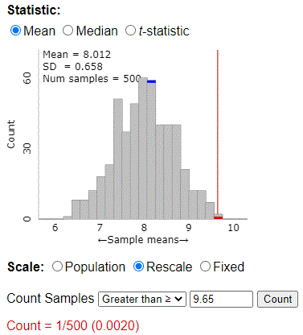
Question 3 – clt activity from section 2.2 of asynch
2. What is the range of the 500 sample means(smallest value and largest value)?
Min
Max
The smallest of the 500 sample means is about 6.3, and the largest is about 9.65.

Slide 13
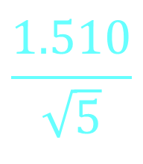
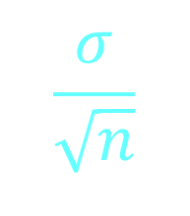
Question 3 – clt activity from section 2.2 of asynch
3. What is the standard deviation of the 500 sample means?
The standard deviation of the 500 sample means is 0.658
This is very close to the standard deviation of the sampling distribution from our simulation!
The result shows that our sampling distribution is consistent with the fact that the standard deviation of the average should approach the population standard deviation divided by the square root of the sample size.
The standard deviation of the average
aka
Standard deviation of the sampling distribution for the sample mean
$$\frac{σ}{\sqrt{n}}$$
$$\frac{1.510}{\sqrt{5}}$$
=
=
=
0.6725

Slide 14
Question 3 – clt activity from section 2.2 of asynch
4. Describe the distribution of 500 sample means from samples of size 5 (think shape, center, and spread).
Population
Sampling distribution of the sample mean
The shape is approximately normal, centered at approximately the mean of the populations distribution (~8).
From CLT we know that the sampling distribution of the sample mean will be approximately normal…
Regardless of the underlying distributions shape if we take large enough samples (which we didn’t do here, our samples were size 5).
Regardless of sample size provided the underlying population we sample from is normally distributed (which is the case here).
The sampling distribution is less spread out than the populations distribution. In fact, the standard deviation of the sampling distribution for the average approaches the standard deviation of the population divided by the square root of n!

Slide 15
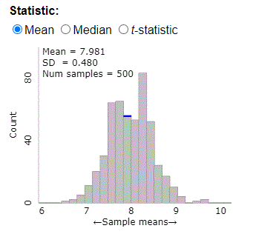
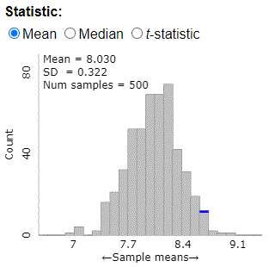
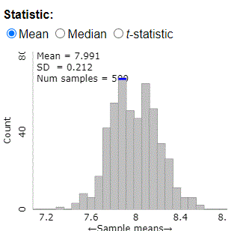
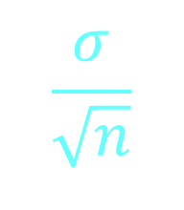
Question 3 – clt activity from section 2.2 of asynch
5. Run the following simulations using the applet. Click “reset” before each simulation!! For each simulation, obtain the mean and standard deviation of the 500 sample means.
Number of samples = 500, sample size = 10
b. Number of samples = 500, sample size = 20
c. Number of samples = 500, samples size = 50
In all three cases the sampling distribution for the sample mean is approximately normally distributed, and is centered close the mean of the population, ~8.
As we increase the sample size notice that standard deviation of the average is consistently decreasing! Intuitively this makes perfect sense. It is less likely for a sample mean to be far from the population mean if the sample size we use is large!
We can quantify this relationship. The standard deviation of the average is equal to the standard deviation of the population divided by the square root of the sample size used when creating the sampling distribution.
$$\frac{σ}{\sqrt{n}}$$

Slide 16
Question 3 – clt activity from section 2.2 of asynch
For each distribution describe the shape of the distribution of the 500 sample means relative to the original population distribution.
500 samples of size 10
500 samples of size 20
500 samples of size 50
Normally distributed.
Centered at approximately µ.
Lower variance than population.
Normally distributed.
Centered at approximately µ.
Lower variance than population.
Lower variance than the size 10 sample distribution.
Normally distributed.
Centered at approximately µ.
Lowest variance of any shown.

Slide 17






Question 3 – clt activity from section 2.2 of asynch
7. For each distribution calculate sigma divided by the square root of n and compare this to the standard deviation of the distribution of the sample means from your simulation.
500 samples of size 10
500 samples of size 20
500 samples of size 50
$$\frac{σ}{\sqrt{n}}$$
$$\frac{1.510}{\sqrt{10}}$$
$$\frac{σ}{\sqrt{n}}$$
$$\frac{1.510}{\sqrt{20}}$$
$$\frac{σ}{\sqrt{n}}$$
$$\frac{1.510}{\sqrt{50}}$$
=
=
0.4775
=
=
0.3376
=
=
0.2135
In all three cases, the standard deviation of the average calculated with the formula $\frac{σ}{\sqrt{n}}$ is very close to the standard deviation found by simulating the process of taking 500 samples of size n, and creating a distribution of the sample means!

Slide 18
Question 3 – clt activity from section 2.2 of asynch
How do the distributions of simulated samples of the same sample size compare to one another (think center, shape, and spread). These are the samples that you see in the middle histogram.
For larger sample sizes, they will resemble the shape of the population distribution, in this case normal.
What would you expect to happen to the distribution of the sample means if we changed the sample size again, to a larger number?
The shape would remain normal, the mean would be close to 8 and the standard error of xbar (the standard deviation of the distribution of all the xbars) would be smaller and close to 1.51/sqrt(n).
What is the pattern that you see?
The standard error gets smaller as n increases. This means the xbars are more likely to be closer to mu! Which means when we conduct the experiment, the one xbar we get is more likely to be closer to mu!

Slide 19
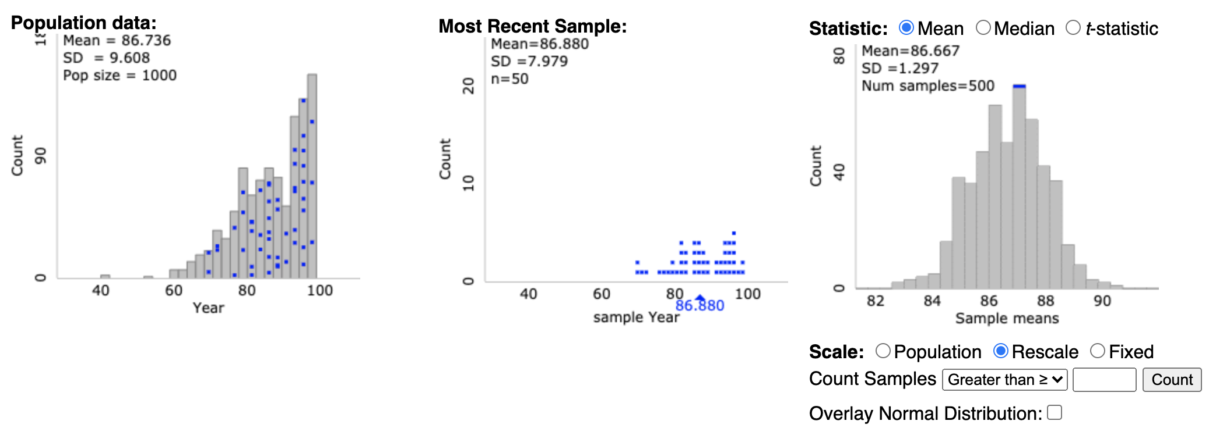
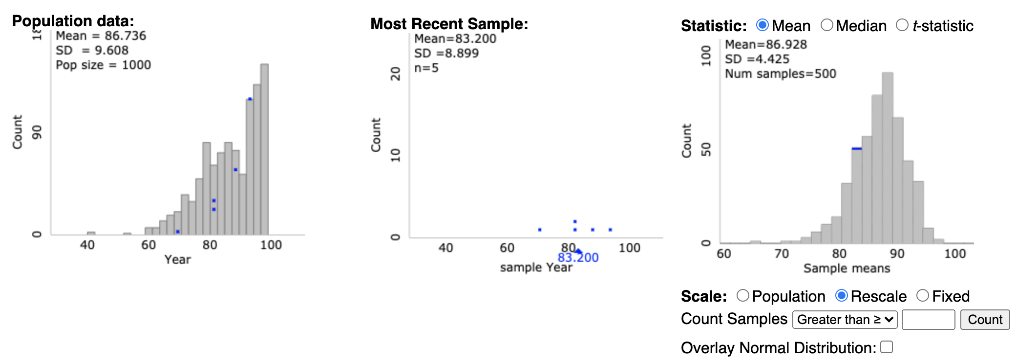
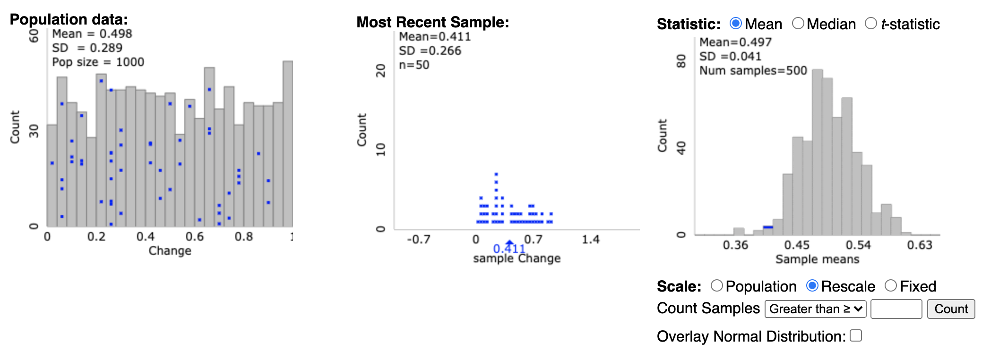
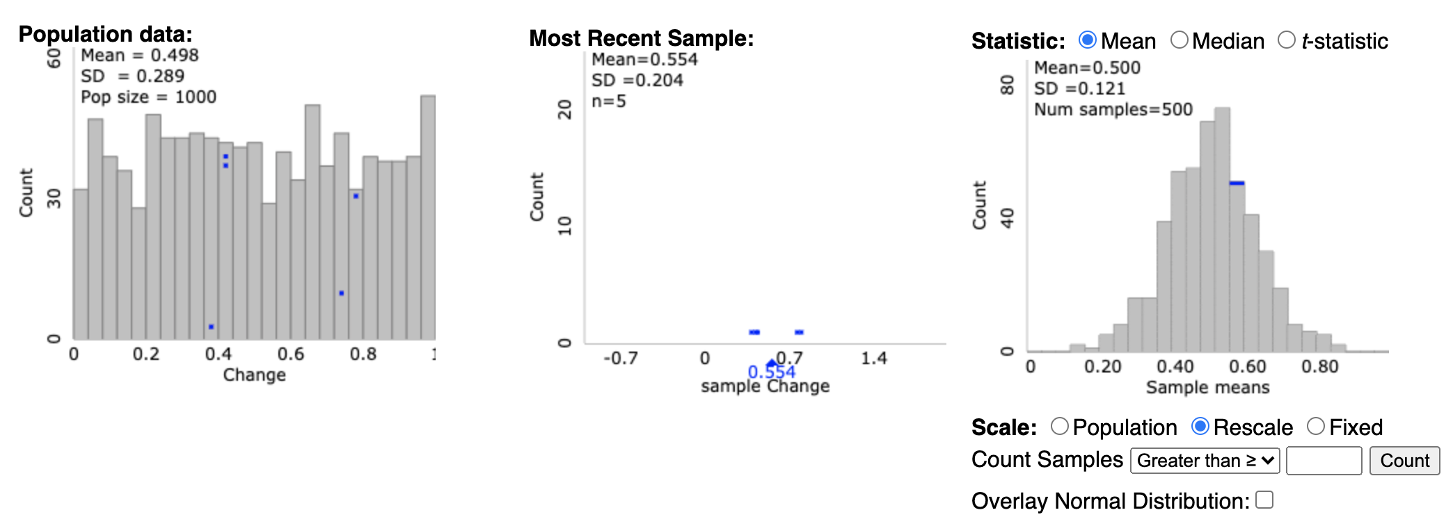
Question 3 – clt activity from section 2.2 of asynch
How do the distributions of simulated samples of the same sample size compare to one another (think center, shape, and spread). These are the samples that you see in the middle histogram.
For larger sample sizes, they will resemble the shape of the population distribution, in this case normal.
What would you expect to happen to the distribution of the sample means if we changed the sample size again, to a larger number?
The shape would remain normal, the mean would be close to 8 and the standard error of xbar (the standard deviation of the distribution of all the xbars) would be smaller and close to 1.51/sqrt(n).
What is the pattern that you see?
The standard error gets smaller as n increases. This means the xbars are more likely to be closer to mu! Which means when we conduct the experiment, the one xbar we get is more likely to be closer to mu!
Foreshadowing for the next section: Do you think the same pattern would result if we took samples and made distributions of sampling statistics for other types of populations (not sleep times)? Try it with “Pennies” and “Change”. (Note, the "Variable" needs to be set in the "Show Sampling Options" section.) What do you see? Yes, if the same sizes are large enough.
n = 50
n = 5

Slide 20
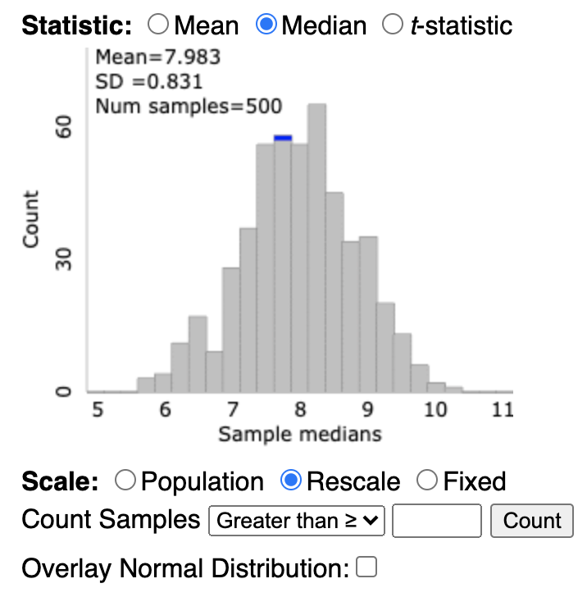
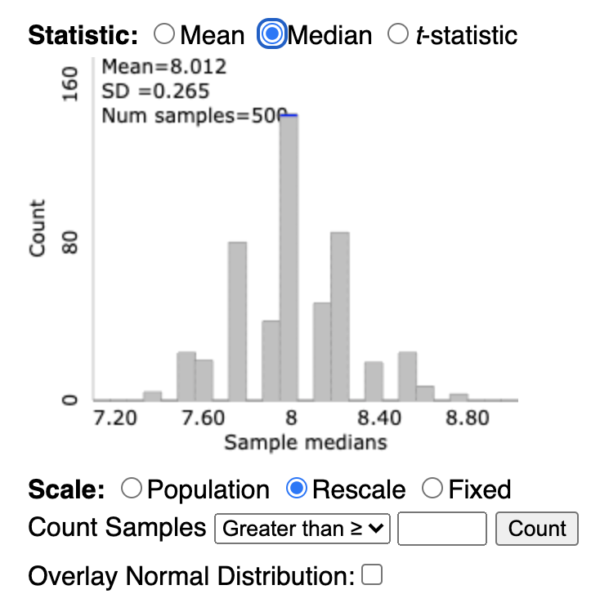
Question 3 – clt activity from section 2.2 of asynch
How do the distributions of simulated samples of the same sample size compare to one another (think center, shape, and spread). These are the samples that you see in the middle histogram.
For larger sample sizes, they will resemble the shape of the population distribution, in this case normal.
What would you expect to happen to the distribution of the sample means if we changed the sample size again, to a larger number?
The shape would remain normal, the mean would be close to 8 and the standard error of xbar (the standard deviation of the distribution of all the xbars) would be smaller and close to 1.51/sqrt(n).
What is the pattern that you see?
The standard error gets smaller as n increases. This means the xbars are more likely to be closer to mu! Which means when we conduct the experiment, the one xbar we get is more likely to be closer to mu!
Fore Shadowing for the next section: Do you think the same pattern would result if we took samples and made distributions of sampling statistics for other types of populations (not sleep times)? Try it with “Pennies” and “Change”. (Note, the "Variable" needs to be set in the "Show Sampling Options" section.) What do you see?
Do you think the same pattern would result if we took samples and made distributions of other sampling statistics (not the mean)? Try it by punching the radio buttons for the median and standard deviation over the plot at the bottom right.
n = 5
n = 50

Slide 21
Question / Activity 4 Review the following … this is a huge concept in tying everything together and will help with HW, Midterm, Final and most importantly, you application of these methods.

Slide 22

Confidence Interval
The following are ages of 7 randomly selected patrons at the Beach Comber in South Mission Beach at 7pm! We assume that the data come from a normal distribution and would like to construct and interpret a 95% confidence interval for the actual mean age of patrons at the Comber. Assume we don’t know the population standard deviation and have estimated it to be 7.08 years. In addition, the t multiplier (t critical value) for this problem is 2.447. The other statistics needed to construct the interval will need to be derived from the data. Show and fully explain your work.
25, 19, 37, 29, 40, 28, 31

Slide 23
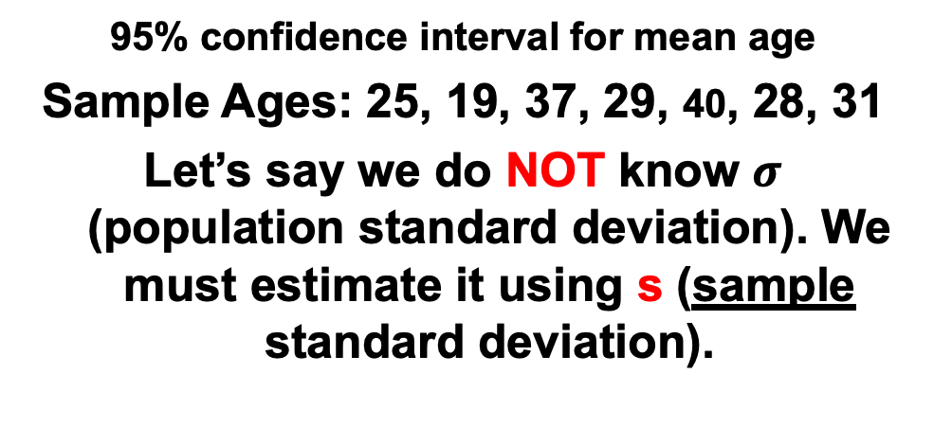

95% confidence interval for mean age
Sample Ages: 25, 19, 37, 29, 40, 28, 31
Let’s say we do NOT know $σ$ (population standard deviation). We must estimate it using s (sample standard deviation).
n = 7
= 29.86
s = 7.08
α = 0.05
α/2 = 0.025
t_{α/2, n-1} = 2.447
x – E < µ < x + E, where
$$\overline{x}$$
E = t_{α / 2, n-1} s = (2.447)(7.08) = 6.55
n
7
IMPORTANT: These are the plausible values of the mean given the data!
29.86 – 6.55 < µ < 29.86 + 6.55
23.31 < μ < 36.41
We are 95% confident that the mean age of Beach Comber patrons at 7pm is contained in the interval (23.31 yrs., 36.41 yrs.).

Slide 24
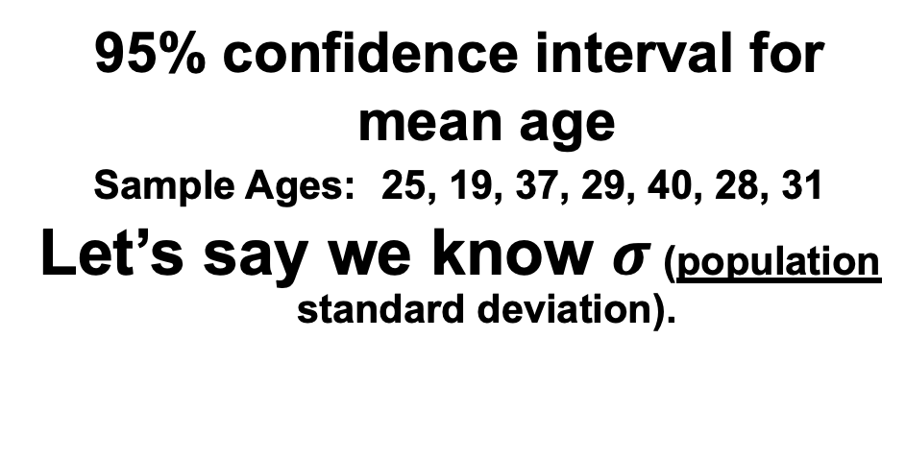
95% confidence interval for mean age
Sample Ages: 25, 19, 37, 29, 40, 28, 31
Let’s say we know $σ$ (population standard deviation).
n = 7
= 29.86
σ = 7.08
α = 0.05
α/2 = 0.025
z_{α/2} = 1.96
x – E < µ < x + E, where
$$\overline{x}$$
E = z_{α / 2} σ = (1.96)(7.08) = 5.24
n
7
29.86 – 5.24 < µ < 29.86 + 5.24
24.62 < μ < 35.10
IMPORTANT: These are the plausible values of the mean given the data!
We are 95% confident that the mean age of Beach Comber patrons at 7pm is contained in the interval (24.62 years, 35.10 years).

Slide 25




Comparison of z to t
E = z_{α / 2} σ = (1.96)(7.08) = 5.24
n = 7
= 29.86
σ = 7.08
α = 0.05
α/2 = 0.025
z_{α/2} = 1.96
$$\overline{x}$$
n
7
x – E < µ < x + E
We are 95% confident that the mean age of Beach Comber patrons at 7pm is contained in the interval (24.62 years, 35.10 years).
29.86 – 5.24 < µ < 29.86 + 5.24
24.62 < μ < 35.10
23.31
24.62
35.10
36.41
E = t_{α / 2, n-1} s = (2.447)(7.08) = 6.55
n = 7
= 29.86
s = 7.08
α = 0.05
α/2 = 0.025
t_{α/2, n-1} = 2.447
$$\overline{x}$$
n
7
$$\overline{x}−E<μ<\overline{x}+E$$
We are 95% confident that the mean age of Beach Comber patrons at 7pm is contained in the interval (23.31 years, 36.41 years).
29.86 – 6.55 < µ < 29.86 + 6.55
23.31 < μ < 36.41

Slide 26
1 Sample Hypothesis Testing: The 6 Steps
Identify H₀ and H_{a}.
Find the Critical Value(s) and Draw and Shade.
Calculate the Test – Statistic. (The evidence!)
Calculate the p-value.
Make a decision… Reject H₀ or FTR H₀.
Write a clear conclusion in the context of the problem…. Use mostly non-statistical terms but always report the p-value! Add a confidence interval if appropriate. End this conclusion with a statement about the scope.

Slide 27
Example: 1 Sample t-test
The following are ages of 7 randomly chosen patrons seen leaving the Beach Comber in South Mission Beach at 7pm! We assume that the data come from a normal distribution and would like to test the claim that the mean age of the distribution of Comber patrons is different than 21. Conduct a 6 step one sample 2-sided t-test with alpha = .05 to test this claim. Provide enough explanation to fully describe each step. Recall that Step 2 is finding the critical value which is the same as the t multiplier in the corresponding 95% confidence interval.
25, 19, 37, 29, 40, 28, 31

Slide 28
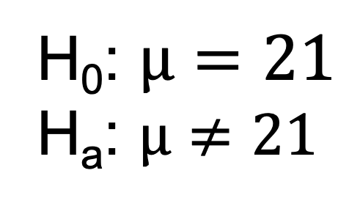
Let’s Formalize This Test Into 6 Steps!
We would like to test the claim that the population mean is d$ifferent than 21.$
Step 1: Identify the null (H₀) and alternative (H_{a}) hypothesis.
H₀: $µ=21$
H_{a}: $µ≠21$

Slide 29
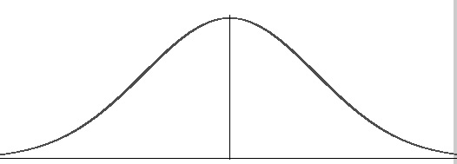
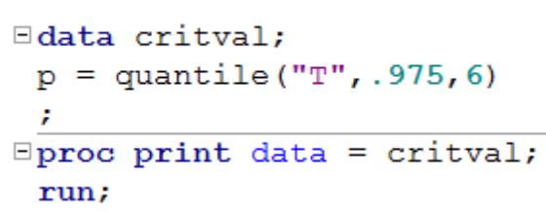
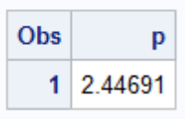


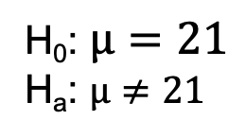





Let’s Formalize This Test Into 6 Steps!
We would like to test the claim that the population mean is d$ifferent from 21.$
To do this, we take a sample of size n = 7.
Step 1: Identify the null (H₀) and alternative (H_{a}) hypothesis.
H₀: $µ=21$
H_{a}: $µ≠21$
Step 2: Draw and Shade and Find the Critical Value.
$α$ = 0.05 = significance level.
df = 7 – 1 = 6
$$0.025$$
$$0.025$$
$$\overline{x}$$
21
t
$$t_{.025, 6}=−2.447$$
$$t_{.975,6}=2.447$$

Slide 30


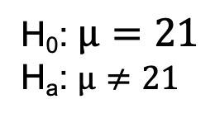

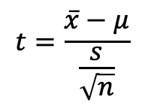



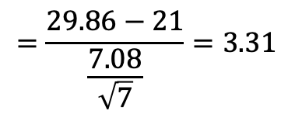

Let’s Formalize This Test Into 6 Steps!
We would like to test the claim that the population mean is not equal to $21.$ To do this, we take a sample of size n = 7 and find that $\overline{x}$ = 29.86 years and s = 7.08 years.
Step 1: Identify the null (H₀) and alternative (H_{a}) hypothesis.
H₀: $µ=21$
H_{a}: $µ≠21$
Step 2: Draw and Shade and Find the Critical Value.
$α$ = 0.05 = significance level.
df = 7 – 1 = 6
$$0.025$$
0$.025$
$$\overline{x}$$
21
t
$$t_{.025, 6}=−2.447$$
$$t_{.975, 6}=2.447$$
$$3.31$$
Step 3: Find the test statistic. (The t value for the data.)
$$t=\frac{\overline{x}−μ}{\frac{s}{\sqrt{n}}}$$
$$=\frac{29.86−21}{\frac{7.08}{\sqrt{7}}}=3.31$$

Slide 31

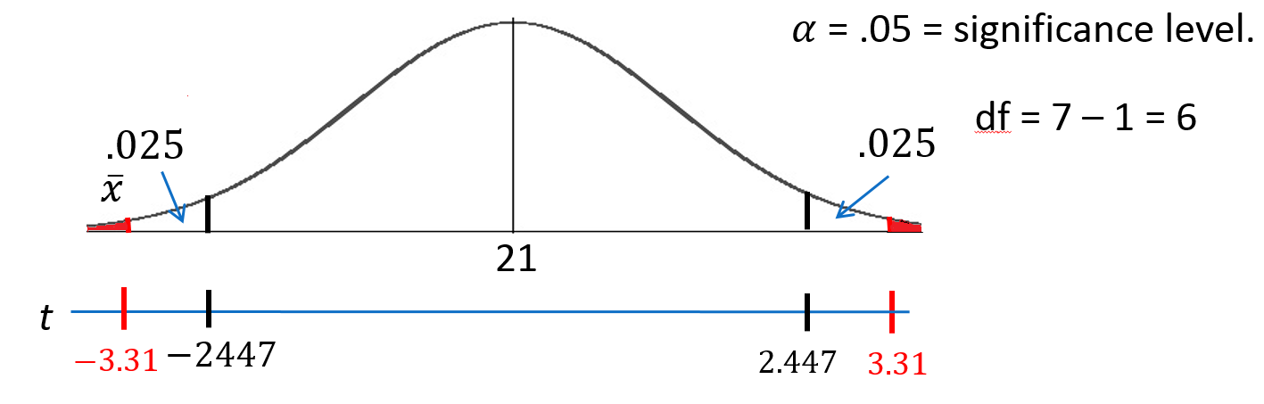

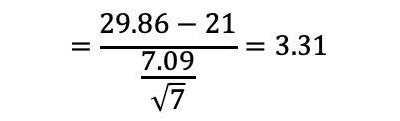
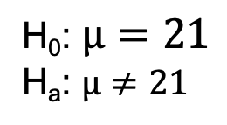
Let’s Formalize This Test Into 6 Steps!
We would like to test the claim that the population mean is n$ot equal to 21.$ To do this, we take a sample of size n = 8 and find that $\overline{x}$ = 29.86 years and s = 7.09 years.
Step 1: Identify the null (H₀) and alternative (H_{a}) hypothesis.
H₀: $µ=21$
H_{a}: $µ≠21$
Step 2: Draw and Shade and Find the Critical Value.
Step 3: Find the test statistic. (The t value for the data.)
$$=\frac{29.86−21}{\frac{7.09}{\sqrt{7}}}=3.31$$
$$t=\frac{\overline{x}−μ}{\frac{s}{\sqrt{n}}}$$
Step 4: Find the p-value: The probability of observing by random chance something as extreme or more extreme than what was observed under the assumption that the null hypothesis is true. (Usually found with software.) The red shaded region above is 0.0162 (sum of both red areas)

Slide 32

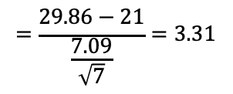
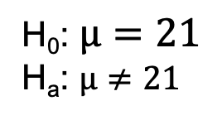
Let’s Formalize This Test Into 6 Steps!
We would like to test the claim that the population mean is n$ot equal to 21.$ To do this, we take a sample of size n = 8 and find that $\overline{x}$ = 29.86 years and s = 7.09 years.
Step 1: Identify the null (H₀) and alternative (H_{a}) hypothesis.
H₀: $µ=21$
H_{a}: $µ≠21$
Step 2: Draw and Shade and Find the Critical Value.
Step 3: Find the test statistic. (The t value for the data.)
$$=\frac{29.86−21}{\frac{7.09}{\sqrt{7}}}=3.31$$
$$t=\frac{\overline{x}−μ}{\frac{s}{\sqrt{n}}}$$
Step 4: Find the p-value: P-value 0.0162< .05
Step 5: Key! The sample mean we found is very unusual under the assumption that the true mean age is 21. So we Reject the assumption that the true mean age is 21. That is, we REJECT H₀.

Slide 33



Let’s Formalize This Test Into 6 Steps!
We would like to test the claim that the population mean is not equal to 21. To do this, we take a sample of size n = 8 and find that $\overline{x}$ = 29.86 years and s = 7.09 years.
H₀: $µ=21$
H_{a}: $µ≠21$
Step 1: Identify the null (H₀) and alternative (H_{a}) hypothesis.
Step 2: Draw and Shade and Find the Critical Value.
$$=\frac{29.86−21}{\frac{7.09}{\sqrt{7}}}$$
$$=3.31$$
$$t=\frac{\overline{x}−μ}{\frac{s}{\sqrt{n}}}$$
Step 3: Find the test statistic. (The t value for the data.)
Step 4: Find the p-value: P-value 0.0162 < 0.05
Step 5: REJECT H₀
Step 6: There is sufficient evidence to conclude that the true mean age of patrons at the Comber at 7pm is not equal to 21 (p-value =0.0162 from a t-test). We could also say that there is sufficient evidence to conclude that the true mean is greater than 21. (Consider the red area in the right most tail.) This was not a random sample of all times, only at 7pm; thus, the result cannot be applied to the bar at all times. The results are nevertheless intriguing.

Slide 34
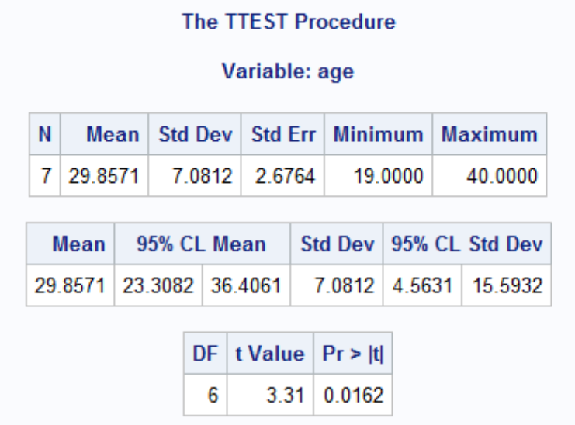
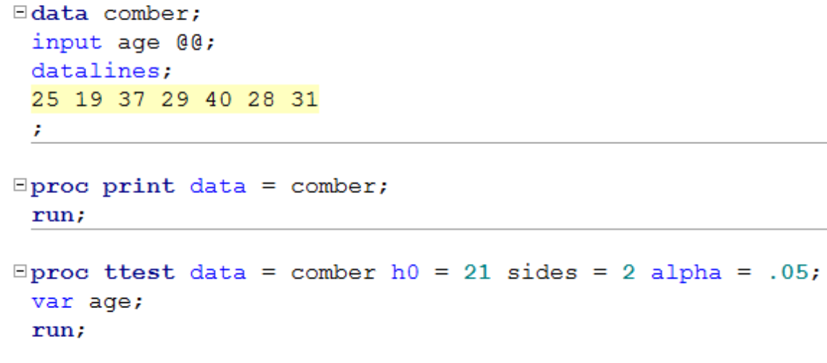
Finding the P-value – more detail
Step 4: Find the p-value: p-value < 0.05
You could use Stat Trek / or the t-table.
OR
Software like SAS:
Confidence interval
* The @@ symbol tells SAS to read the data “sideways” in a row.

Slide 35
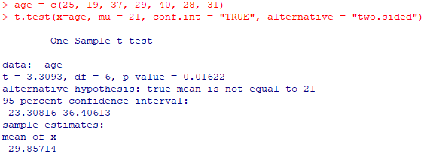
Finding the P-value – more detail
Step 4: Find the p-value: p-value < 0.05
Using R:
Confidence interval

Slide 36
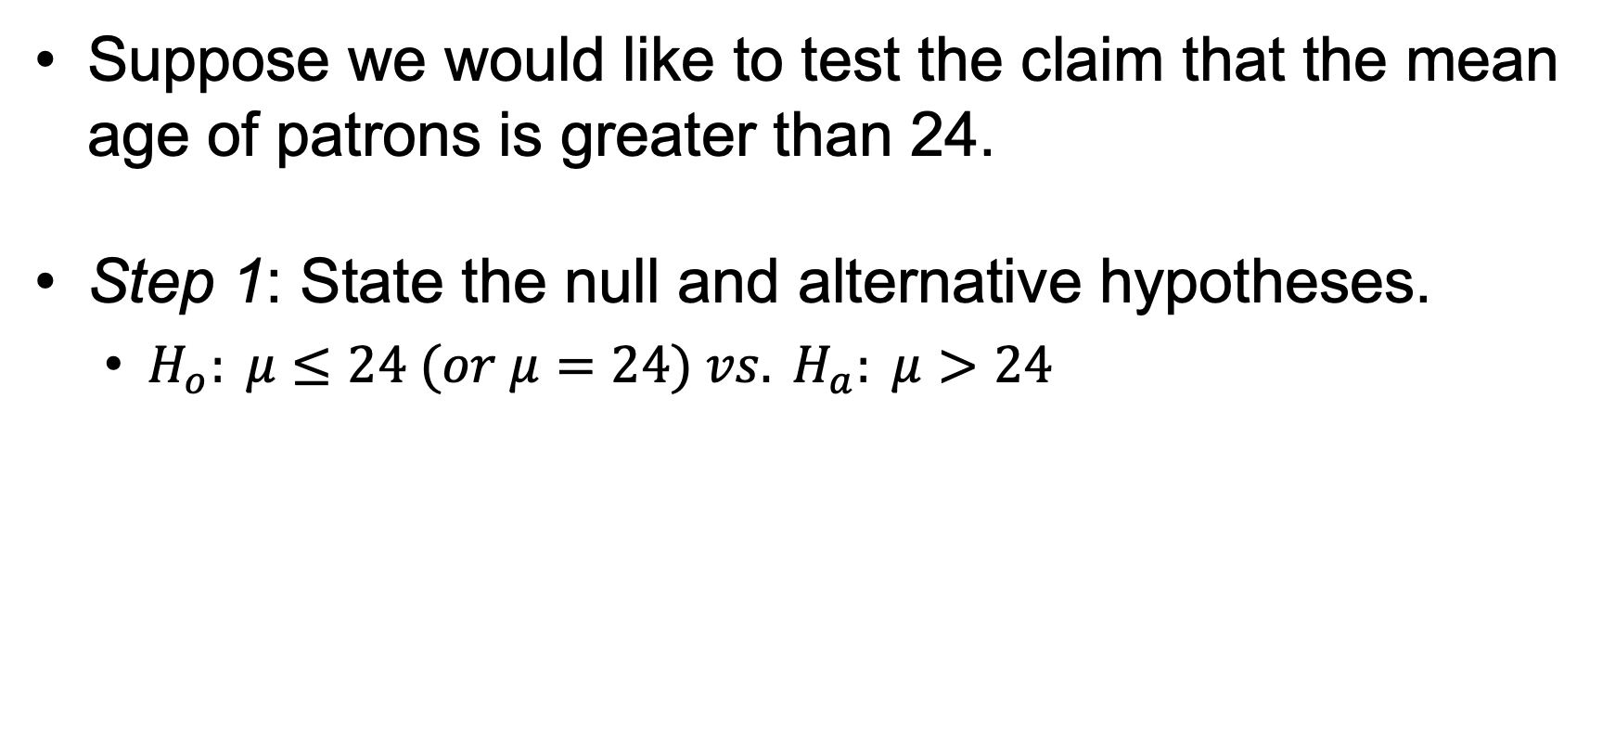
One-Sided Test + Two-Sided CI Demonstration
Suppose we would like to test the claim that the mean age of patrons is greater than 24.
Step 1: State the null and alternative hypotheses.
$H_{o}: μ≤24 (or μ=24) vs. H_{a}: μ>24$

Slide 37
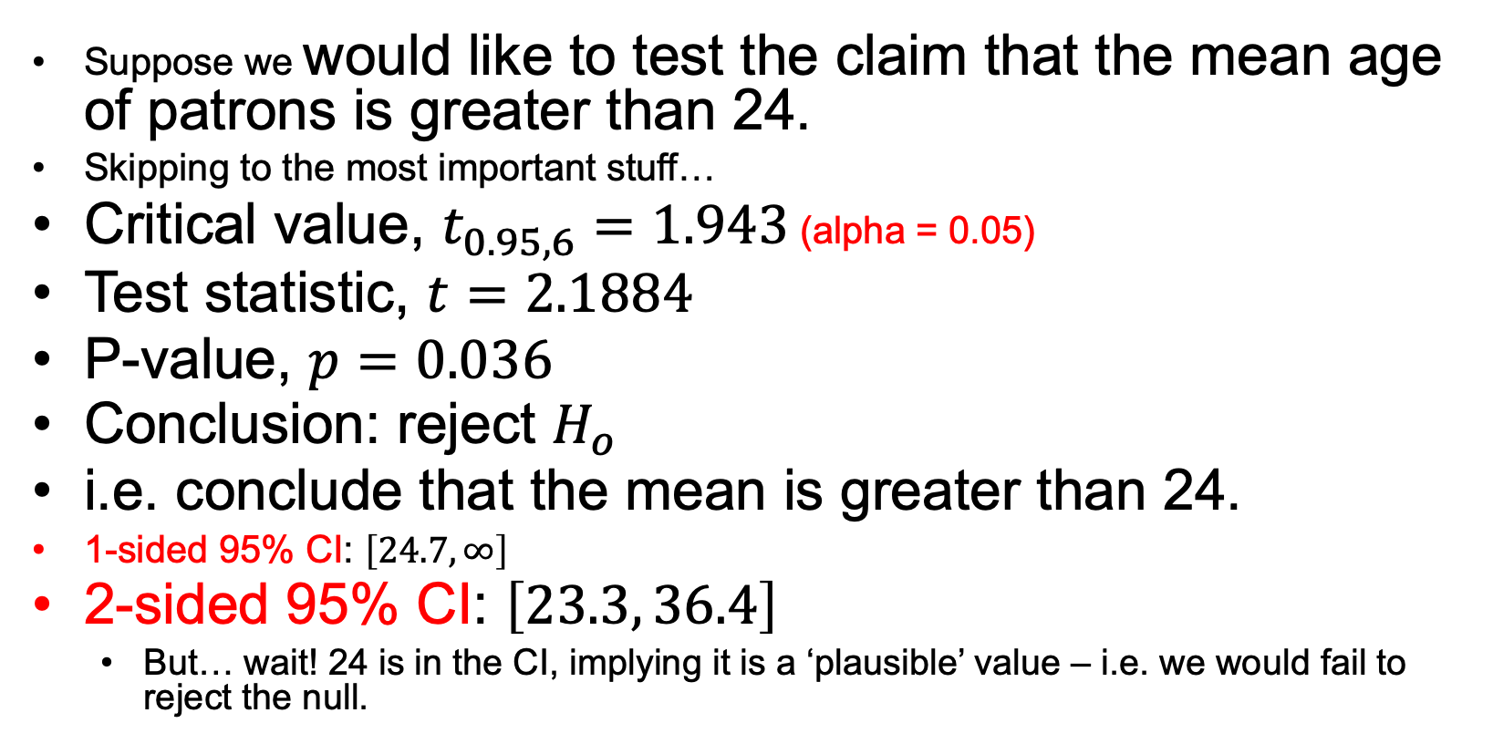
One-Sided Test + Two-Sided CI Demonstration
Suppose we would like to test the claim that the mean age of patrons is greater than 24.
Skipping to the most important stuff…
Critical value, $t_{0.95, 6}=1.943$ (alpha = 0.05)
Test statistic, $t=2.1884$
P-value, $p=0.036$
Conclusion: reject $H_{o}$
i.e. conclude that the mean is greater than 24.
1-sided 95% CI: $\left[24.7, ∞\right]$
2-sided 95% CI: $\left[23.3, 36.4\right]$
But… wait! 24 is in the CI, implying it is a ‘plausible’ value – i.e. we would fail to reject the null.

Slide 38
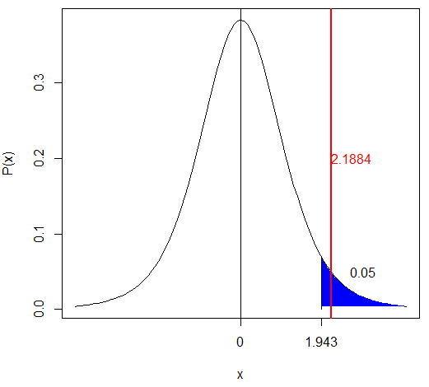
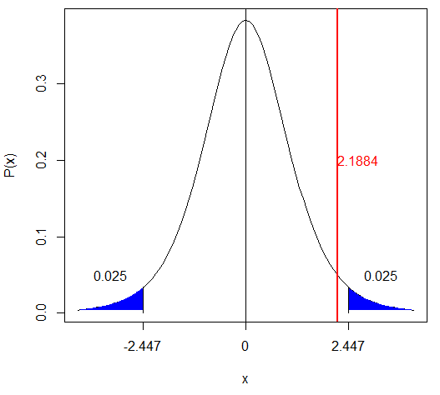
One-Sided Test + Two-Sided CI Demonstration
Suppose we would like to test the claim that the mean age of patrons is greater than 24.
One Sided-Test at alpha = 0.05
Two Sided-Test at alpha = 0.05

Slide 39
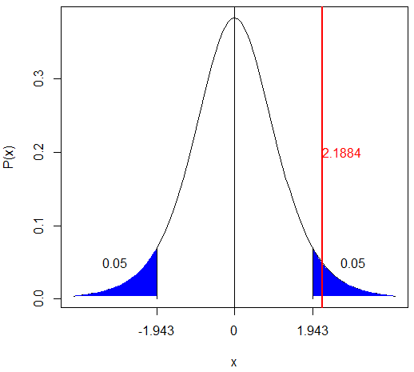
One-Sided Test + Two-Sided CI Demonstration
Suppose we would like to test the claim that the mean age of patrons is greater than 24.
Two Sided-Test at alpha = 0.1
Two Sided-Test at alpha = 0.05

Slide 40

One-Sided Test + Two-Sided CI Demonstration
Take-away: you can run into a situation where a 1-sided p-value at $α$ does not ‘agree’ with a 2-sided $\left(1−α\right)\%$ CI.
This is why you should switch to a $\left(1−2α\right)\%$ CI if you want to ensure that the conclusions will agree.

Slide 41
End Question/Activity 4

Slide 42

Question 5
In the United States, it is illegal to discriminate against people based on various attributes. One example is age. An active lawsuit, filed August 30, 2011, in the Los Angeles District Office is a case against the American Samoa Government for systematic age discrimination by preferentially firing older workers. Though the data and details are currently sealed, suppose that a random sample of the ages of fired and not fired people in the American Samoa Government are listed below:
Fired
34 37 37 38 41 42 43 44 44 45 45 45 46 48 49 53 53 54 54 55 56
Not fired
27 33 36 37 38 38 39 42 42 43 43 44 44 44 45 45 45 45 46 46 47 47 48 48 49 49 51 51 52 54
a. Perform a permutation test to test the claim that there is age discrimination. Provide the Ho and Ha, the p-value, and full statistical conclusion, including the scope (inference on population and causal inference). Note: this was similar to an example in Live Session 1. You may start from scratch or use the sample code and PowerPoints from Live Session 1.
b. Now run a two sample t-test appropriate for this scientific problem. (Use SAS.) (Note: we may not have talked much about a two-sided versus a one-sided test. If you would like to read the discussion on pg. 44 (Statistical Sleuth), you can run a one-sided test if it seems appropriate. Otherwise, just run a two-sided test as in class. There are also examples in the Statistics Bridge Course.) Be sure to include all six steps, a statistical conclusion, and scope of inference.
c. Compare this p-value to the randomized p-value found in the previous sub-question.
d. The jury wants to see a range of plausible values for the difference in means between the fired and not fired groups. Provide them with a confidence interval for the difference of means and an interpretation.
e. Given the sample standard deviations from SAS, calculate by hand
i. Pooled standard deviation (s_{p})
ii. The standard error of (${\overline{X}}_{FIRED}−{\overline{X}}_{Not Fired}$)
f. Inspect and run this R Code and compare the results (t statistic, p-value, and confidence interval) to those you found in SAS. To run the code, simply copy and paste the code below into R.
Fired = c(34, 37, 37, 38, 41, 42, 43, 44, 44, 45, 45, 45, 46, 48, 49, 53, 53, 54, 54, 55, 56)
Not_fired = c(27, 33, 36, 37, 38, 38, 39, 42, 42, 43, 43, 44, 44, 44, 45, 45, 45, 45, 46, 46, 47, 47, 48, 48, 49, 49, 51, 51, 52, 54)
t.test(x = Fired, y = Not_fired, conf.int = .95, var.equal = TRUE, alternative = "two.sided")

Slide 43
Question 5
In the United States, it is illegal to discriminate against people based on various attributes. One example is age. An active lawsuit, filed August 30, 2011, in the Los Angeles District Office is a case against the American Samoa Government for systematic age discrimination by preferentially firing older workers. Though the data and details are currently sealed, suppose that a random sample of the ages of fired and not fired people in the American Samoa Government are listed below:
Fired: 34 37 37 38 41 42 43 44 44 45 45 45 46 48 49 53 53 54 54 55 56
Not fired: 27 33 36 37 38 38 39 42 42 43 43 44 44 44 45 45 45 45 46 46 47 47 48 48 49 49 51 51 52 54

Slide 44




Question 5
a. Perform a permutation test to test the claim that there is age discrimination. Provide the Ho and Ha, the p-value, and full statistical conclusion, including the scope (inference on population and causal inference). Note: this was similar to an example in Live Session 1. You may start from scratch or use the sample code and PowerPoints from Live Session 1.
Assumption: That there is no mean difference in mean age for those who were fired and not fired.
$$H_{0}: µ_{ fired}−µ_{ notfired}=0$$
$$H_{a}: µ_{ fired}−µ_{ notfired}≠0$$
$$x_{ not_fired }^{̶ }=43.93333$$
Our evidence is the difference in mean ages for the 21 individuals who we know were fired, and the 30 individuals who were not fired.
$$x_{fired }^{̶ }=45.8571$$
$x_{fired}^{̶ }−$ $x_{ notfired}^{̶ }=45.8571−43.93333=1.9238$ years
We want to understand how rare it would be to observe a 1.9238 year difference in the mean ages for samples of 21 individuals who were fired and 30 who were not fired, if the true mean age difference between the populations of fired and not fired individuals is zero (i.e. if the null hypothesis is correct).

Slide 45
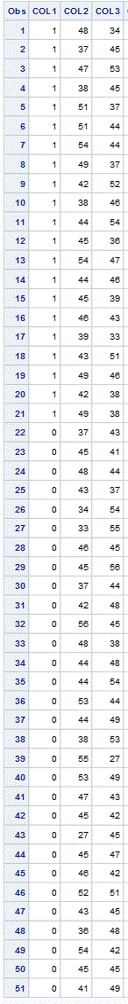
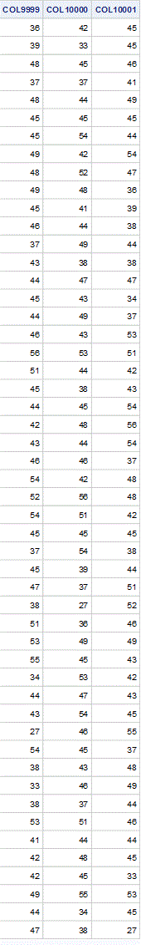






Question 5a continued
Class Fired
1 = fired
0 = not fired
Random permutation of ages #1
Random permutation of ages #10,000
Use SAS to create 10,000 random permutations of the ages.
(Randomly assign one of the ages to each of the fired and not fired labels)
Create the confidence limits table
This shows the difference in means for the two groups, for all 10k permutations. (example for permutation #2 below).
…

Slide 46



Question 5
Calculate the number of random permutations where the difference in means was as extreme or more extreme than the differences our evidence shows ($1.9238$ years).
…
2747 of the 10,000 random permutations produced a difference in means as extreme or more extreme than the difference we observed in our evidence.

Slide 47


Question 5a continued
Create a histogram of the differences in means,${ x}_{ fired}^{̶ }−$ $x_{ notfired}^{̶ }$, for all 10,000
Randomly permuted samples.
Observed value in study , 1.9238
Calculate the p-value estimate:
2747/10000 = 0.2747
This p-value estimate tells us that we would expect to see a difference in observed means (fired – not_fired) as extreme or more extreme than our evidence (1.9238) about 27.47% of the time just by randomness in the sampling process, if the null hypothesis is true.
All of these random permutations had a difference in means (fired– notfired) as extreme or more extreme than our evidence!

Slide 48


Question 5a – permutation test conclusion
$$H_{0}: µ_{ fired}−µ_{ notfired}=0$$
$$H_{a}: µ_{ fired}−µ_{ notfired}≠0$$
We conclude that there is not statistically significant evidence that the true mean difference in age between individuals who were not fired and those who were fired is not zero (p-value 0.2747, permutation test with 10k permutations).
As this was an observational study (we could not randomly assign fired or not fired to the subjects), we were studying the association between mean age and the fired vs not fired status of these individuals. In other words, a causal relationship regarding age and fired vs not fired status would not directly follow from these results.
Regarding generalization to a larger population, we are told that the sample we received is a random sample of the ages of fired and not fired people in the American Samoa government. This means it is reasonable to generalize our results to this larger population, and say we did not find statistically significant evidence of an association between age and fired vs not fired status of individuals in the American Samoa government.

Slide 49


Question 5b t-test
5b. Now run a two sample t-test appropriate for this scientific problem. (Use SAS.) (Note: we may not have talked much about a two-sided versus a one-sided test. If you would like to read the discussion on pg. 44 (Statistical Sleuth), you can run a one-sided test if it seems appropriate. Otherwise, just run a two-sided test as in class. There are also examples in the Statistics Bridge Course.) Be sure to include all six steps, a statistical conclusion, and scope of inference.
If older people are systematically getting fired more, it seems reasonable that the average age of those who have been fired would be higher than the average for those who are not fired.
Note: The accusation is that older people are being fired. This could be accomplished with either a one or two sided test. For simplicity, we will perform the two sided test.
Step 1 identify the null and alternative hypothesis:
$$H_{0}: µ_{ fired}−µ_{ not−fired}=0$$
$$H_{a}: µ_{ fired}−µ_{ not−fired}≠ 0$$

Slide 50
Question 5b t-test
5b. Now run a two sample t-test appropriate for this scientific problem. (Use SAS.) (Note: we may not have talked much about a two-sided versus a one-sided test. If you would like to read the discussion on pg. 44 (Statistical Sleuth), you can run a one-sided test if it seems appropriate. Otherwise, just run a two-sided test as in class. There are also examples in the Statistics Bridge Course.) Be sure to include all six steps, a statistical conclusion, and scope of inference.
Step 1 identify the null and alternative hypothesis:
$$H_{0}: µ_{ fired}−µ_{ not−fired}=0$$
$$H_{a}: µ_{ fired}−µ_{ not−fired}≠ 0$$

Slide 51






Question 5b t-test
Step 3: Find the test statistic
Step 2: Find the critical value, draw and shade the distribution.
;
$${\overline{x}}_{Fired }−{\overline{x}}_{notfired}$$
t = 1.10
Step 4: Find the p-value
For alpha = 0.05, the two-sided t-test has a t_critical value of +/- 2.01.
SAS also gives the two-sided p-value as 0.2771.
This means the probability of observing a difference in mean ages as extreme or more extreme than a 1.10 standard deviations away from the mean, assuming that the mean age of the fired group is the same as the mean age of the not fired group, is 0.2771.

Slide 52
Question 5b t-test
From SAS we see that the one-sided (left) t-test for a difference in means, with 49 degrees of freedom and an equal variance assumption gives a test statistic of
1.10
Step 3: Find the test statistic
Step 2: Find the critical value, draw and shade the distribution.
;
$${\overline{x}}_{Fired }−{\overline{x}}_{notfired}$$
t = 1.10
Step 4: Find the p-value
For alpha = 0.05, the two-sided t-test has a t_critical value of +/- 2.01.
SAS also gives the two-sided p-value as 0.2771.
This means the probability of observing a difference in mean ages as extreme or more extreme than a 1.10 standard deviations away from the mean, assuming that the mean age of the fired group is the same as the mean age of the not fired group, is 0.2771.

Slide 53
Question 5b t-test
Step 5 – reject or fail to reject:
We fail to reject the null hypothesis.
Step 6 – Conclusion with scope of inference statement and p-value:
We conclude that there is not sufficient evidence that the true mean age of individuals who have been fired at the American Samoan government is different than the mean age of the individuals who have not been fired (P-value = 0.2771, two sample, two-sided t-test).
As this was an observational study (we could not randomly assign subjects to be fired or not fired to the subjects), we were studying the association between mean age and the fired vs not fired status of these individuals. In other words, a causal relationship regarding age and fired vs not fired status would not directly follow from these results.
Regarding generalization to a larger population, we are told that the sample we received is a random sample of the ages of fired and not fired people in the American Samoa government. This means it is reasonable to generalize our results to this larger population, and say we did not find statistically significant evidence of an association between increased age and a higher chance of being fired.

Slide 54
Solution
Step 1:
Step 2:
Step 3:
Step 4:
Step 5:
Step 6:

Slide 55



Question 5c p-value comparison
5c. Compare the t-test p-value to the randomized p-value found in the previous sub-question.
T-test:
.2771
Permutation test p-value:
2747/10000 = 0.2747
The P-values for the t-test and permutation test are almost identical!

Slide 56










5d – plausible values
The jury wants to see a range of plausible values for the difference in means between the fired and not fired groups. Provide them with a confidence interval for the difference of means and an interpretation.
The ”multiplier”
Standard error of the sampling distribution for the difference in sample means.
Est +/- Mult * SE(EST)
100(1 – α)% Confidence Limits for the Difference Between Means:
$Ȳ_{Fired}−Ȳ_{NotFired} ± t_{\frac{α}{2},df}SE(Ȳ_{Fired}−Ȳ_{Not Fired}$)
Margin of error
$$Ȳ_{Fired}−Ȳ_{NotFired}=Ȳ_{Fired}−Ȳ_{ NotFired }=45.8571−43.93333 =1.9238$$
Putting it all together….
(-1.5943, 5.4419)
$$df=n_{fired}+n_{ not fired }−2=21+30 −2=49$$
$1.9238±2.010 ∗1.7503$
$$t_{df}=2.010$$
Note: Same as critical value.
Found with qt(.975,49)
$SE(Ȳ_{Fired}−Ȳ_{NotFired}\text{)}\text{ = 1.7503}$
Here we sanity check and see that our 95% confidence interval (above) agrees with the output from the SAS two sided t-test!

Slide 57








5e – hand calculations
Given the sample standard deviations from SAS, calculate by hand pooled standard deviation and standard error.
1 = Fired
2 = Not Fired
ii. The standard error of (${\overline{X}}_{FIRED}−{\overline{X}}_{Not Fired}$)
Note: The pooled standard deviation is based on an assumption that the two populations have the same standard deviation. If this is the case, then the two sample standard deviations are separate estimates of the same value. Therefore “pooling” is just us taking a weighted average of the two estimates of the single (by assumption) population standard deviation.
i. Pooled standard deviation (s_{p})
$$SE(Ȳ_{1}−Ȳ_{2}\text{)}= s_{p}\sqrt{\frac{1}{n_{1}}+\frac{1}{n_{2}}}$$
$$s_{p}= \sqrt{\frac{\left(n_{1}−1\right)s_{1}^{2}+\left(n_{2}−1\right)s_{2}^{2}}{n_{1}+n_{2}−2}}$$
$$SE(Ȳ_{2}−Ȳ_{1}\text{)}=6.15186 ∗\sqrt{\frac{1}{21}+\frac{1}{30}}$$
$$SE(Ȳ_{2}−Ȳ_{1}\text{)}=1.75034$$
$$s_{1 }=6.5214 , s_{2 }=5.8835$$
$$n_{1 }=21 , n_{2 }=30$$
$$s_{p}= \sqrt{\frac{\left(21−1\right){6.5214}^{2}+\left(30−1\right){5.8835}^{2}}{21 +30−2}}$$
$$s_{p}=6.15186$$
Matches SAS!

Slide 58

5f – R code
Inspect and run this R Code and compare the results (t statistic, p-value, and confidence interval) to those you found in SAS. To run the code, simply copy and paste the code below into R.
Fired = c(34, 37, 37, 38, 41, 42, 43, 44, 44, 45, 45, 45, 46, 48, 49, 53, 53, 54, 54, 55, 56)
Not_fired = c(27, 33, 36, 37, 38, 38, 39, 42, 42, 43, 43, 44, 44, 44, 45, 45, 45, 45, 46, 46, 47, 47, 48, 48, 49, 49, 51, 51, 52, 54)
t.test(x = Fired, y = Not_fired, conf.int = .95, var.equal = TRUE, alternative = "two.sided")
Test Statistic and
95% Confidence Interval
Pvalue!

Slide 59
BREAKOUT! YOU TRY IT!
There are a lot of SAT test prep companies out there and we wanted to conduct a study to see if there was an effect with respect to one of them (The Princeton Review (PR)) versus a not having any prep at all (None)). Conduct a 6 step two sample t-test to test for a difference. To test this, 1000 students who did not have any prep were randomly selected from Texas and there SAT scores were recorded. Another 1000 students who did receive the Princeton Review were randomly selected from Texas and their scores were recorded. The data are in the file TestPrep.csv. Include a 95% confidence interval in your conclusion. Comment on if this result is a) statistically significant and / or practically significant. Also provide a scope of inference.

Slide 60

Solution
$$Ho:μ_{None}=μ_{PR}$$
$$Ha:μ_{None}≠μ_{PR}$$
Critical Value: +/- 1.96
Test Statistic: -2.2258
Pvalue: .02616
Decision: Reject Ho
Conclusion: There is strong evidence to suggest that the mean score of those who took the Princeton Review is greater than the mean score of those who did not take a test prep course (Pvalue = .02616). We are 95% confident that the mean score of the Princeton Review group is between 1.0 and 16.5 points larger that the mean score of those who did not take a test preparation course.
This was not a randomized experiment thus we can only draw an association between the mean score and the test preparation course. Since this was a random

